Slide 1


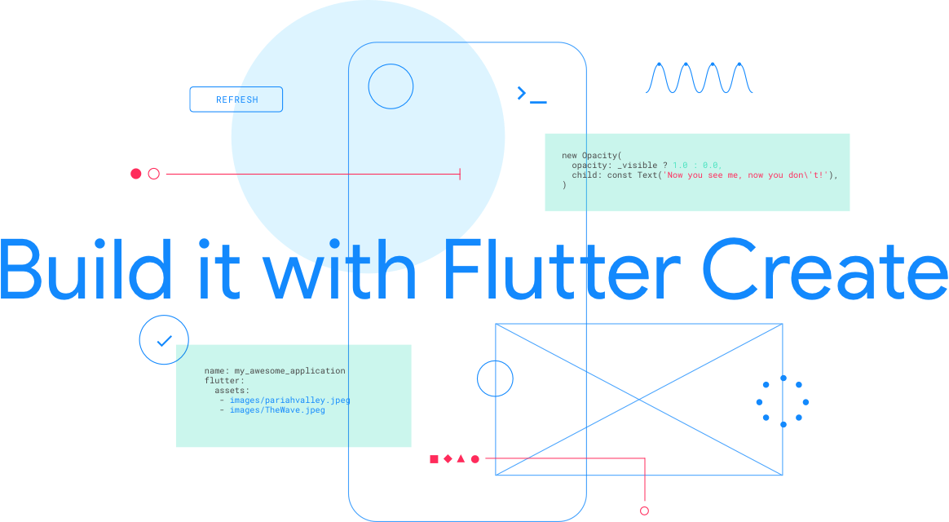

Get Started with Flutter
Session by
R P S Naik
Flutter, MEAN Stack Developer
7 Days free live session

Slide 2
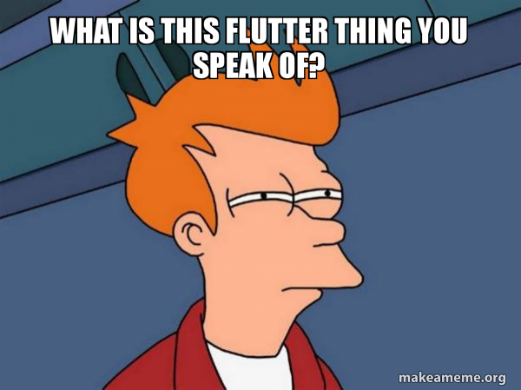
What the Heck is that !

Slide 3

What is Flutter ?
Flutter is Google’s UI toolkit for building beautiful, natively compiled applications for mobile, web, and desktop from a single codebase.

Slide 4
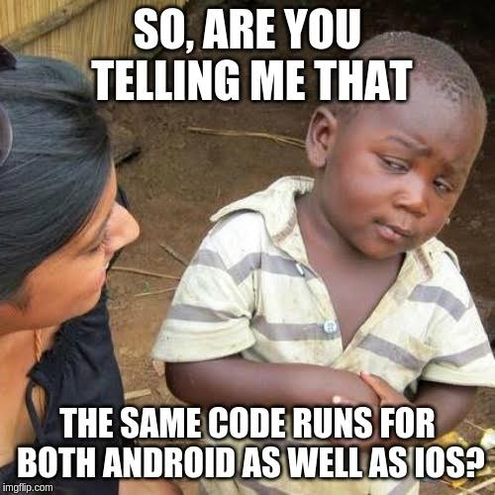
Yes Bro! Exactly! 😁😂😂

Slide 5
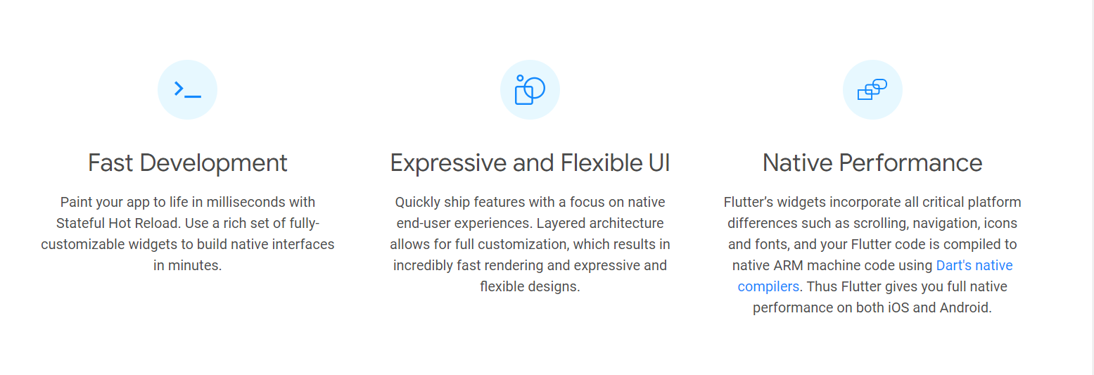
Why Flutter ?

Slide 6
What is Dart and why Dart ?
Dart allows Flutter to avoid the need for a separate declarative layout language like JSX or XML, or separate visual interface builders, because Dart’s declarative, programmatic layout is easy to read and visualize
Dart is Smooth Fast Efficient Effective and Productive
Which enabled Animation rate to 60 FPS for Flutter Apps

Slide 7

What made Flutter a hot topic🔥 in Developer Communities
Insanely hot ; )

Slide 8
What made Flutter a hot topic🔥 in Developer Communities
Of Course Hot Reloading
Faster Development
Fundamentally, Flutter is for users that want beautiful apps, with delightful motion and animation, and UIs with character and an identity all their own.
No prior mobile experience is required in order to learn and use Flutter.

Slide 9
Who is our Serious Competitor 🤨?

Slide 10
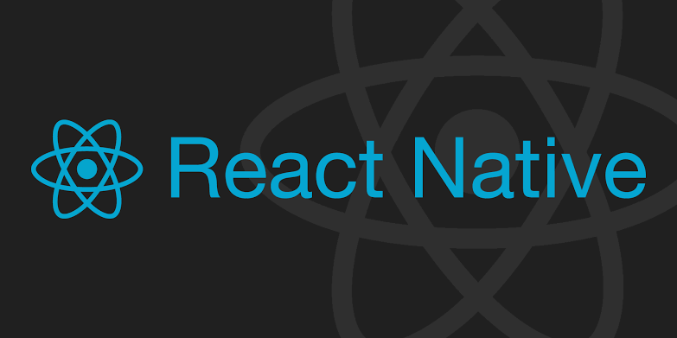
Who is our Serious Competitor 🤨?

Slide 11
How Flutter is different👻 from React Native ?

Slide 12
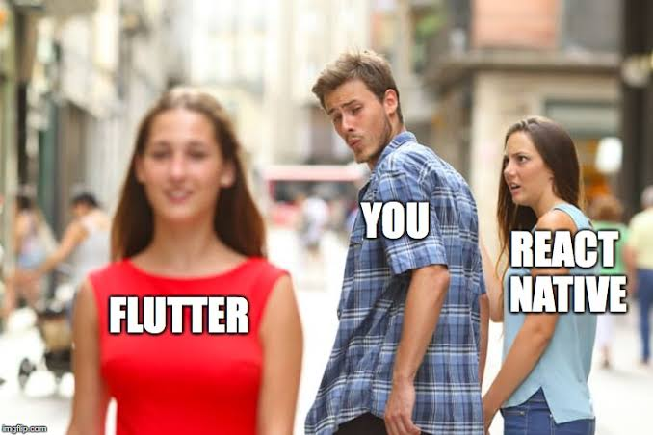

Slide 13
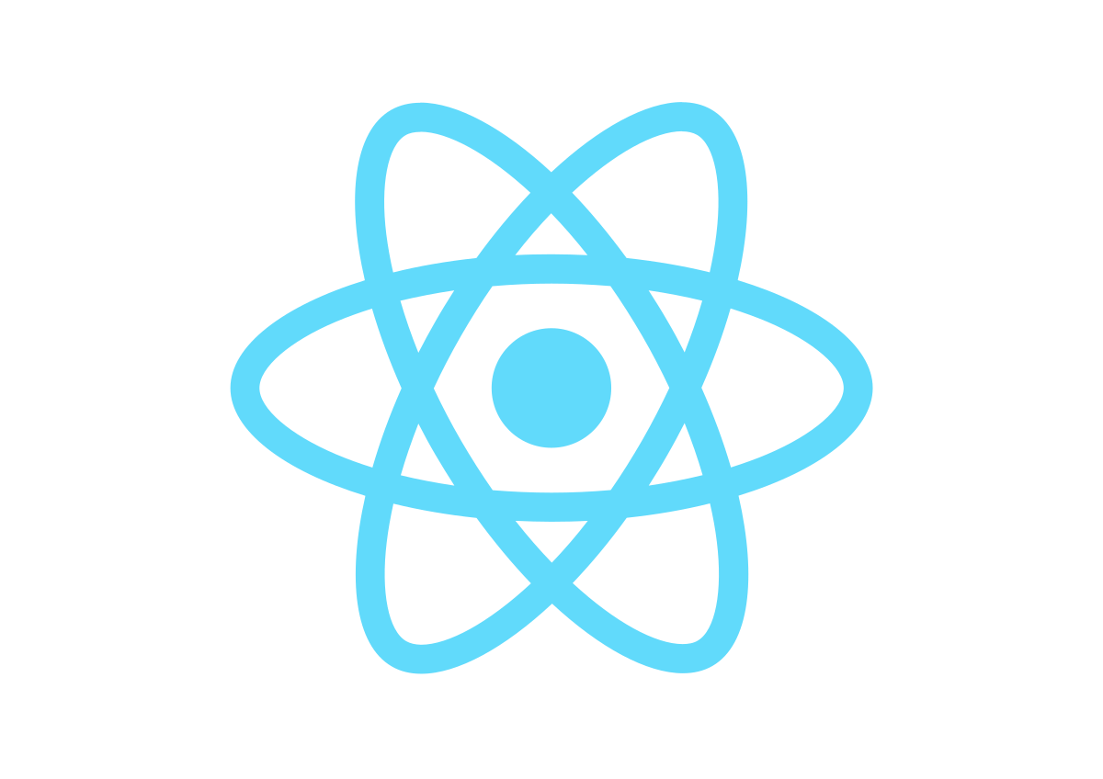
How Flutter is different👻 from React Native ?
Flutter
React Native
Backed by Google
App Performance – Purely Native
UI – Proprietary customized widgets
60 FPS Support – Yes
JIT and AOT - Yes
Backed by Facebook
Fairly Robust
UI – Native Components
60 FPS Support – Requires workaround
JIT and AOT - No

Slide 14
Widgets Everywhere!
Widgets are the basic building blocks in a Flutter Application

Slide 15
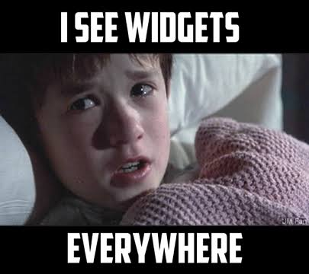

Slide 16
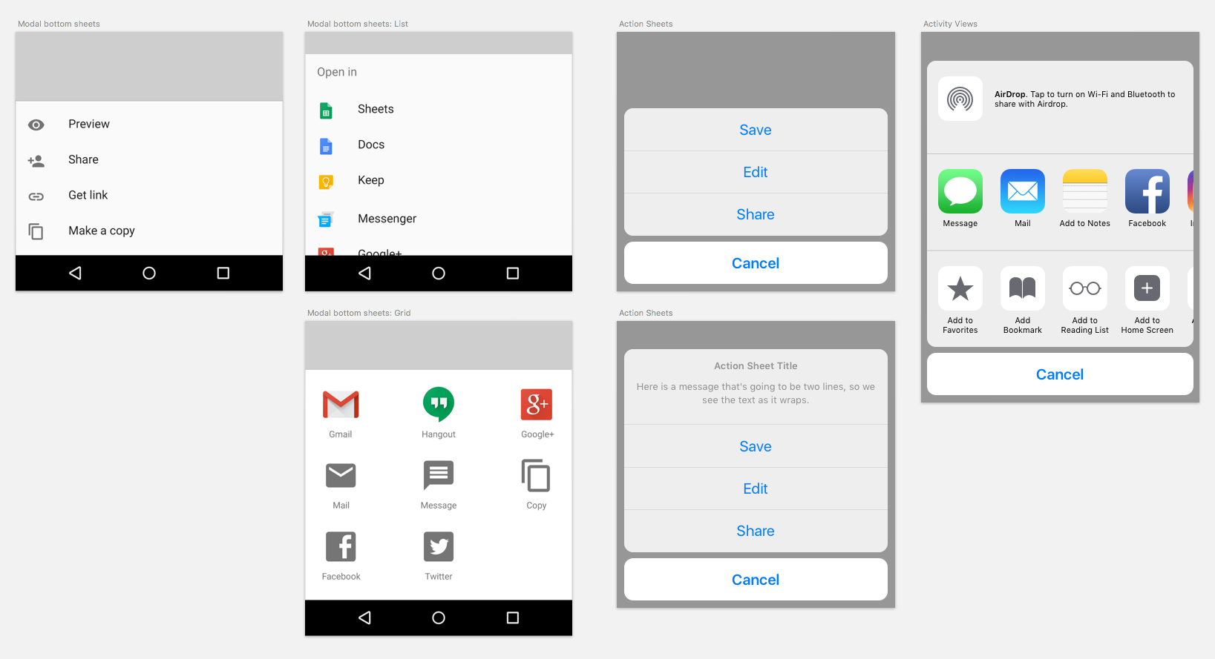
How Flutter maintain Native experience over various Platforms
We have the Cupertino Package for iOS
We got the Material Components for Android Apps
…

Slide 17
Animations
Flutter Enables 60 FPS independent of what platform the application is based on

Slide 18
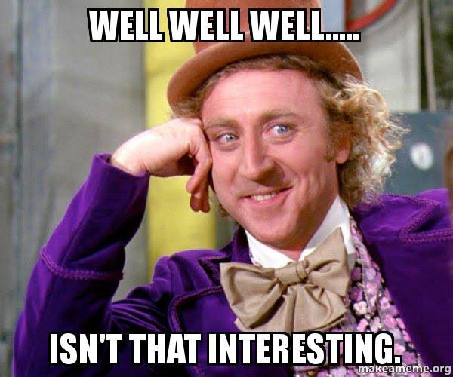

Slide 19
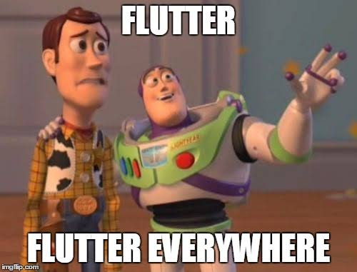

Slide 20
Let’s get messed up ; ) It’s time for Installation! and build our First App

Slide 21
What we will be learning in these 7 Days
Day 1 – Introduction to Flutter - Dart and I/O in Dart, Control Statements, Functions, Loops etc
Day 2 – Object Oriented Programming
Day 3 – Installation of Flutter SDK and building your first Flutter app
Day 4 – Basic Widgets and Stateful and Stateless widgets
Day 5 – More Widgets (Since flutter comes with 1000 of widgets)
Day 6 – Builders, Navigators, HTTP, API Data Handling, Streams in Flutter
Day 7 – Final Project – Nextflix Clone

Slide 22
Day 1 of Flutter Masterclass
What is Flutter ?
Why we need to learn Flutter ?
What and Why Dart ?
Procedural Level Programming in Dart
Variables, Loops, Lists, Functions, Control Statements etc
Day 1 Code Available at http://github.com/rpsnaik and find the repo of “Flutter Masterclass for 7 Days”

Slide 23
Thank you!

